Slide 1
Español AP
Sra. Brenda J. Castañeda
Contact information:
bcastaneda@madisoncity.k12.al.us
At the end of this course students should be able to say the following “I can…” statements.
I can express myself freely and spontaneously, and for the most part accurately, on concrete topics and on most complex issues.
I can deliver well-organized presentations on concrete social, academic, and professional topics. I can present detailed information about events and experiences in various time frames
Write on a variety of general interest topics, professional, academic and personal.
I can easily follow narrative, informational, and descriptive texts.
I can sometimes understand extended arguments and different points of view.
Goal for this year: Advanced low-high
Our mission: In the Comprehensible Classroom: To provide a space for positive collaboration to create active learning environments that foster student engagement and empowerment.
Technology: Access at home needed.
Use of electronic devices in class will be at the discretion of the instructor.
Neither teacher nor school is responsible for stolen, broken or lost devices.
Class expectations:
Always Respect
Always Participate
Always in Target Language
3 bathroom passes every 9 weeks
No food once in class.
No unauthorized cell phone use.
This course is conducted in Spanish. Immersion is proven to be the most effective path to proficiency in a second language. It is normal for students to feel frustrated and lost at the beginning. Trust the process. We will have time dedicated to speaking English and clearing up misunderstandings.

Slide 2
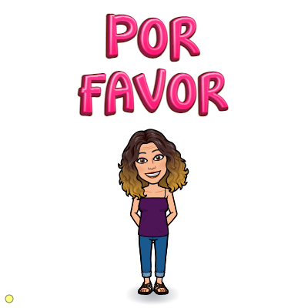
Using speaking, listening, reading and writing strategies we will explore the following topics as well as target language cultural awareness through music, literature, video and other authentic materials. These topics will be practiced in multiple time frames throughout the course. All AP themes will be explored.
1st 9wks:
Relationships and our treatment of others
Towards the future
Home life and relationships
2nd 9wks
Beauty and esthetics lifestyles and art
Traditions and celebrations
The environment and climate issues
Late assignments due to technology problems will be treated as any other late assignment and deductions and/or no credit given will be determined on a case by case basis.
- If you do not have internet access at home, please see me for an individual plan.
6 GOALS to accomplish our mission...
To not be afraid of a second language environment
Take risks and break down the filter (it’s ok to make mistakes)
To be able to infer and circumlocute
To use the second language 100% of the time
To participate and be a part of a community
To cultivate intrinsic motivation and student empowerment
Class expectations: also read MCS expectations
Always Respect
Always Participate
Always in Target Language
Alwyas Prepare
3 bathroom passes every 9 weeks
No food once in class.
No unauthorized cell phone use.
Cheating: Is a serious offense. Plagiarism of any kind is cheating. Google translate or other tools used that do not reflect the child’s true growth in WL will be seen as an act of cheating. Zeros can and will be given for any work that was taken from any outside source.

